Slide 1
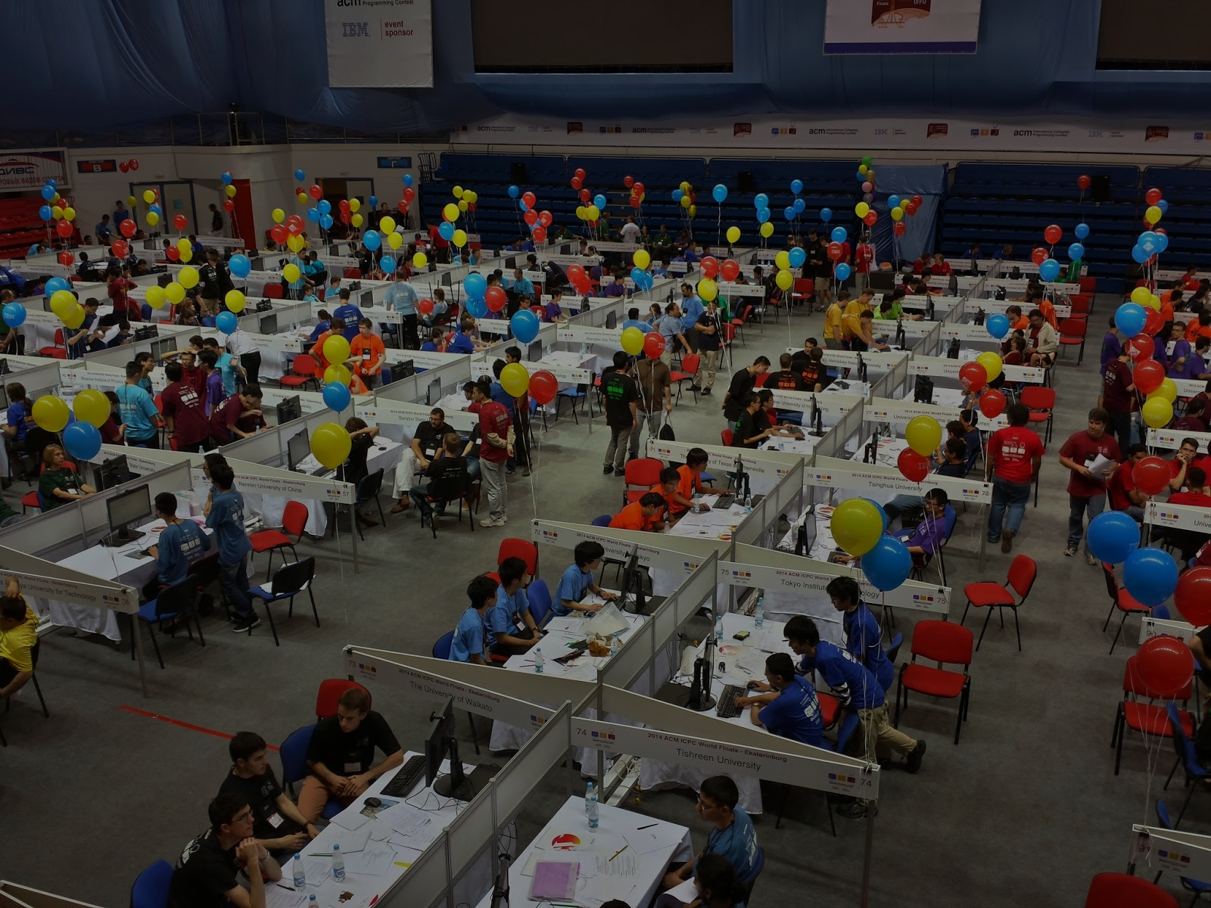

Menoufia University
Faculty of Computers and Information
Supervisor: Dr. Amira Ibrahim

Slide 2
Project Team
Ahmed Samir Daoush
Amr Hassan Saud
Ola Galal ElKhouly
Ola Nazmy Farag

Slide 3
Motivation
The main idea of our project is to provide an environment for problem solving contests. Teachers at the faculty of computers and information face a problem when they want to make an onsite programming exam.

Slide 4
What's our Project ?
PSCE stands for Problem Solving Contest Environment
PSCE is a dynamic distributed real-time system designed to manage and control programming contests in a variety of computing environments
We optimized our code to make the system run smoothly with minimum hardware requirements.

Slide 5
Project Uses
The project gives them the chance of auto-correcting the exam, add their own problems and view real-time scoreboard. It also allows them to answer any clarifications sent by the students. It can also detect plagiarism and exclude students who are cheating. Our Project aims to ease the process of making a quiz or contest inside a university.

Slide 6
Environment Components
Contest Application
Judge Side
Student Side
2. Website
3. Cheating Detection Tool (Plagiarism)

Slide 7
Main Tools used in the creation process …

Slide 8
Desktop Application
Java
FXML
MySQL
Web Application
HTML, CSS, and Bootstrap
JavaScript (MathJax)
Java Servlet and JSP

Slide 9
Our objectives: (based on technical prescriptive):
Design using an easy interface to use by students (contestant) and doctors (judges).
Provide a good user experience (UX) while using the app.
Reduce the complexity of the overall process to improve performance as possible.
Allow fast and concurrent retrieval of information.

Slide 10
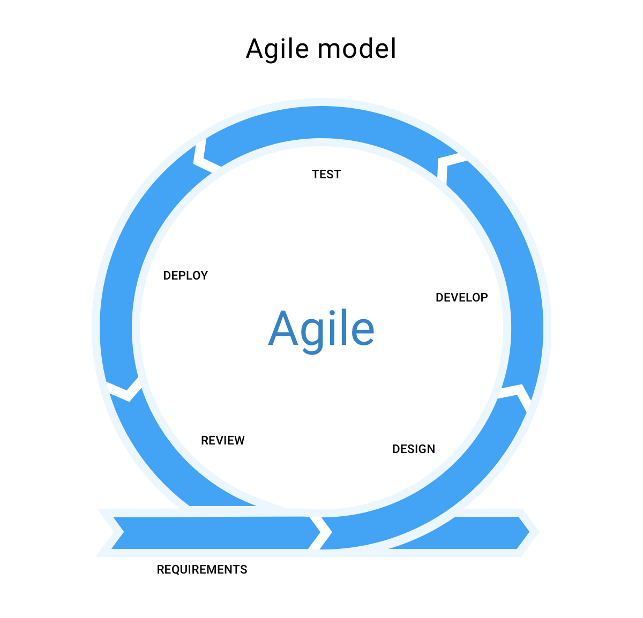
In our project, we used Agile software development.

Slide 11

Software Design Pattern
In our project, we used the Model–view–controller pattern. It is commonly used for developing user interfaces that divides an application into three interconnected parts.

Slide 12
DFD

Slide 13
Important Details:
- We took into consideration the user interface and the user experience (UI/UX) to provide the best and easiest experience when they use the software.

Slide 14
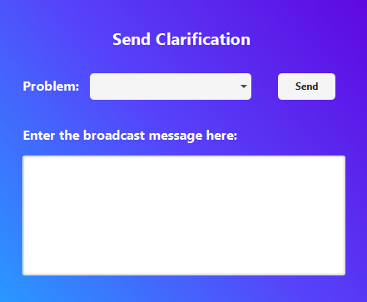
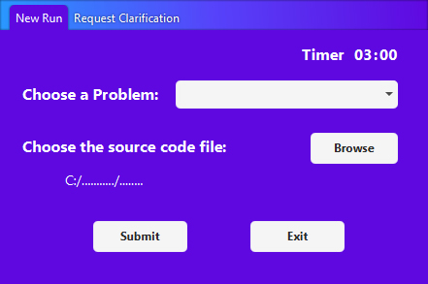
It consists of a desktop application with two different interfaces: Contestant and Judge.
Judge Main Interface
Contestant Main Interface

Slide 15
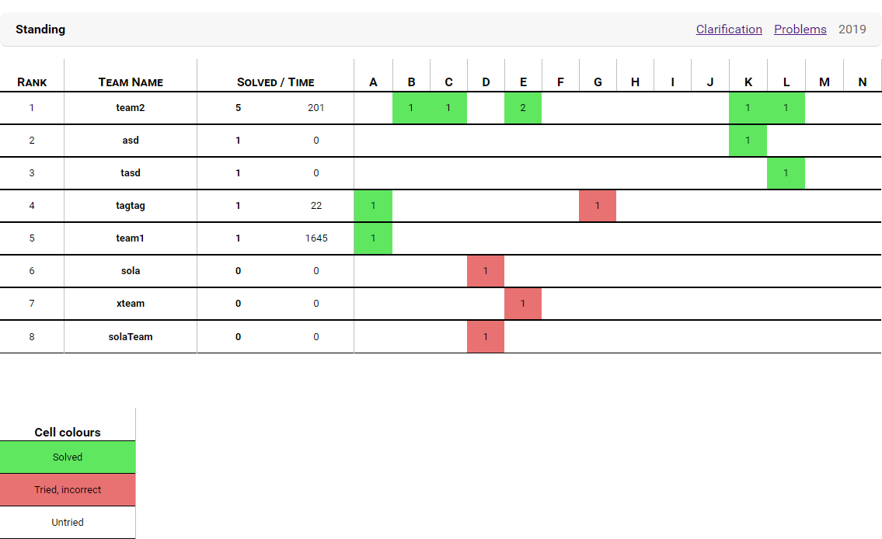

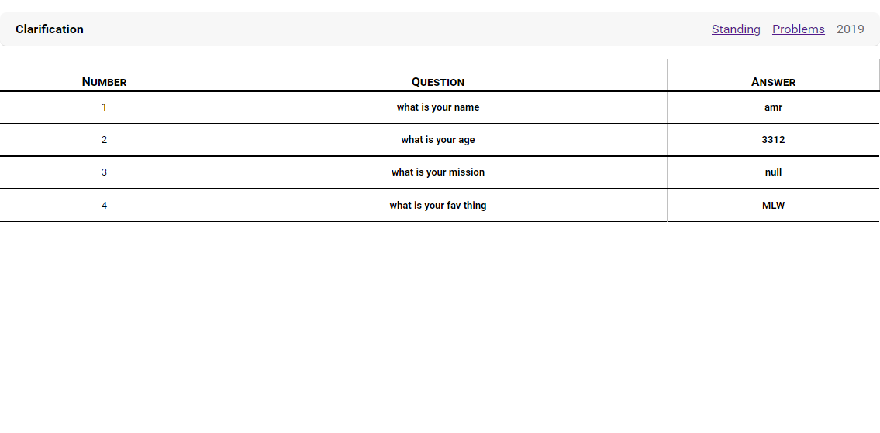
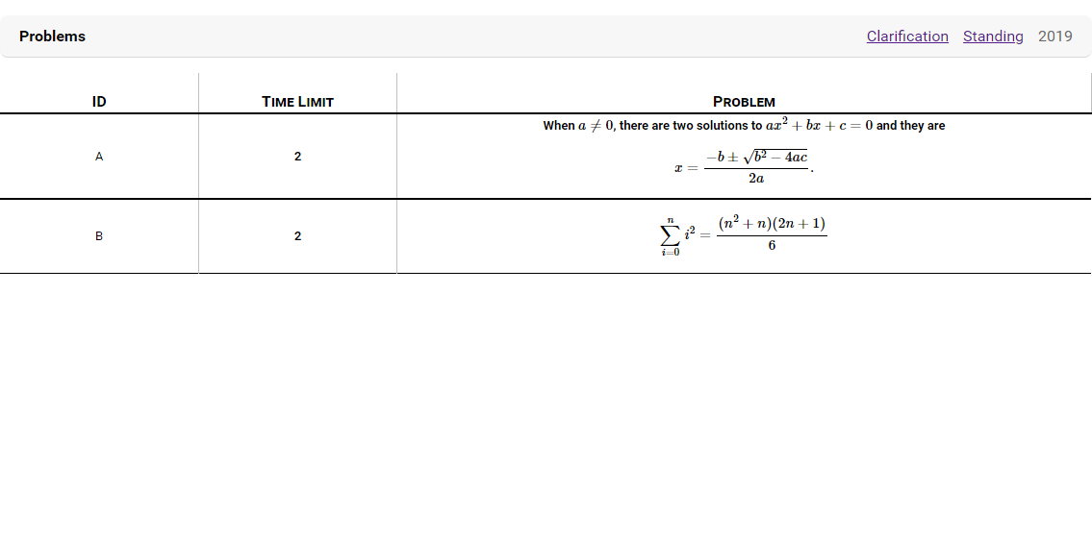
a webpage to view a real-time scoreboard, another webpage to view clarifications and webpage to view problems.

Slide 16
Technologies
3. TeX and MathJax
MathJax is an open-source JavaScript display engine for TeX and AsciiMath notation that works in all modern browsers. It was designed with the goal of consolidating the recent advances in web technologies into a single, definitive, math-on-the-web platform supporting the major browsers and operating systems. It requires no setup on the part of the user.

Slide 17
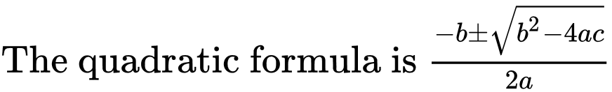
Technologies
3. TeX and MathJax
Markup | Renders as
The quadratic formula is $-b \pm \sqrt{b^2 - 4ac} \over 2a$

Slide 18
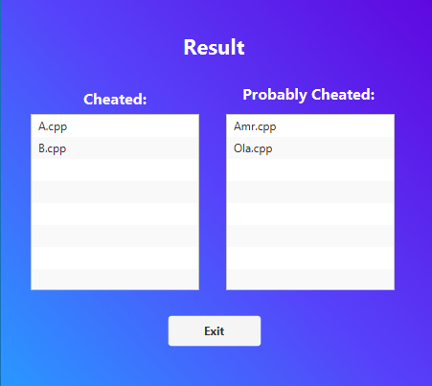
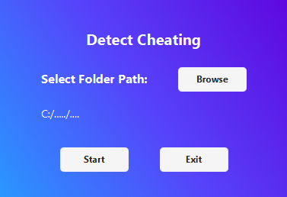
It also contains a tool that helps in detect cheating or code plagiarism. This tool is applied after the contest had finished, then outputs the cheated and probably cheated contestants.

Slide 19
NOW, SOME DETAILS ..

Slide 20
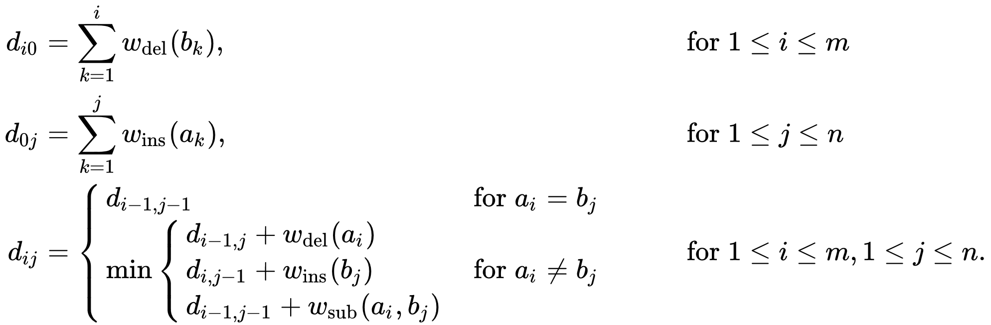
Algorithms
1. Minimum Edit Distance
The minimum edit distance between two strings is the minimum number of editing operations: Insertion, Deletion, Substitution needed to transform one into the other. We used this algorithm in the detection of cheating or plagiarism.

Slide 21
Algorithms
2. Balanced Binary Search Tree
A balanced binary search tree is a tree that automatically keeps its height small (guaranteed to be logarithmic) for a sequence of insertions and deletions. This structure provides efficient implementations for abstract data structures such as associative arrays.

Slide 22
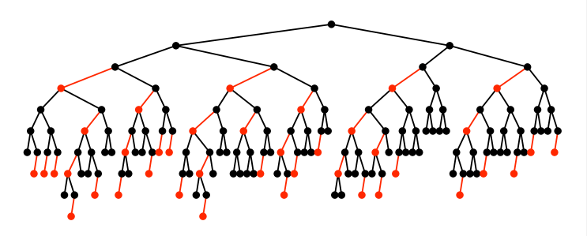
Algorithms
3. Red-Black Tree
Red-Black Tree is a self-balancing Binary Search Tree (BST) where every node follows following rules.
Search and insert operations in a red-black BST are guaranteed to take (2 Log n) at most.

Slide 23
Algorithms
4. Hashing
Hashing is an important Data Structure which is designed to use a special function called the Hash function which is used to map a given value with a particular key for faster access of elements
In our project, we used hashing in for Standing.

Slide 24
Algorithms
5. Quicksort
Quicksort is an efficient sorting algorithm, serving as a systematic method for placing the elements of a random-access file or an array in order.
Mathematical analysis of quicksort shows that, on average, the algorithm takes O(n log n) comparisons to sort n items. In the worst case, it makes O(n2) comparisons, though this behavior is rare.

Slide 25
Technologies
System Calls in Java
A system call is a way for programs to interact with the operating system. A computer program makes a system call when it makes a request to the operating system's kernel. System call provides the services of the operating system to the user programs via Application Program Interface (API).
We used the system calls to handle the submissions of the students during the contest.

Slide 26
Important Details:
- In our project, server management depends on Internet protocol TCP, But why TCP?
- We managed successfully the synchronization between threads and servers, by designing the threads and servers to be independent of each other.
As a result of this independence, the OS dispatcher is the one that responsible for syncing.

Slide 27
Technologies
Socket Programming in Java
Java Socket programming is used for communication between the applications running on different JRE (Java Runtime Environment).
The client in socket programming must know two information:
- IP Address of Server
- The Port number is static and known by both sides

Slide 28
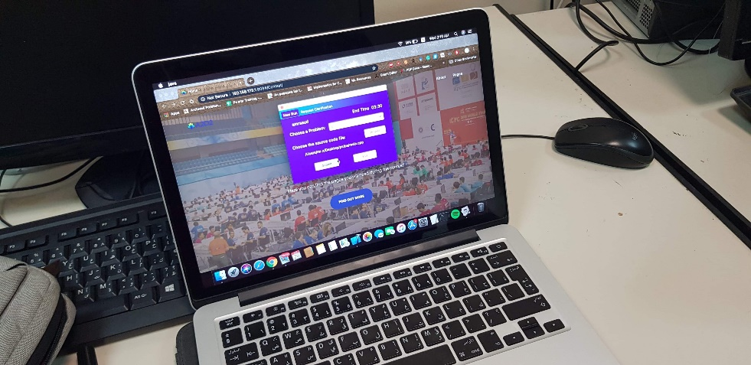
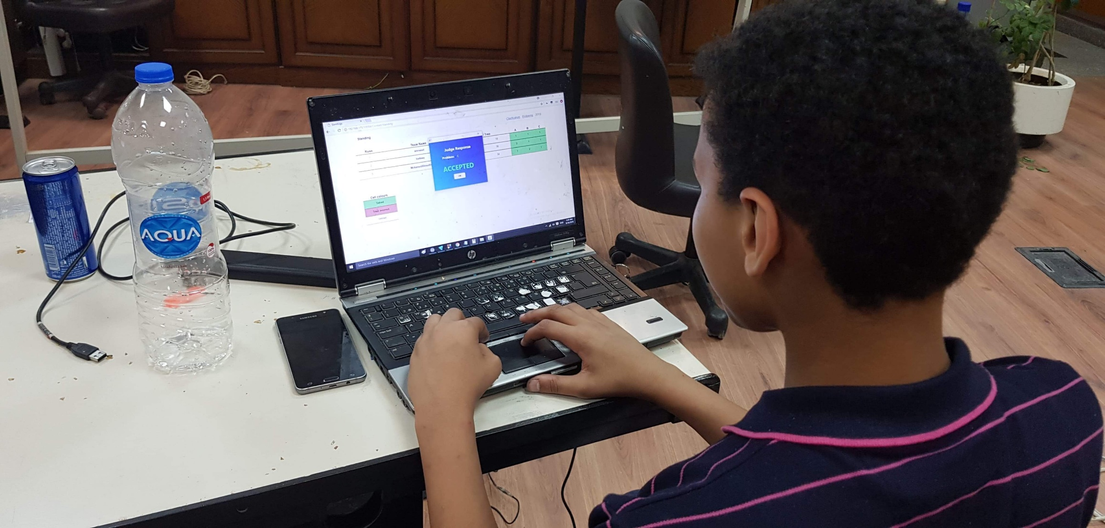
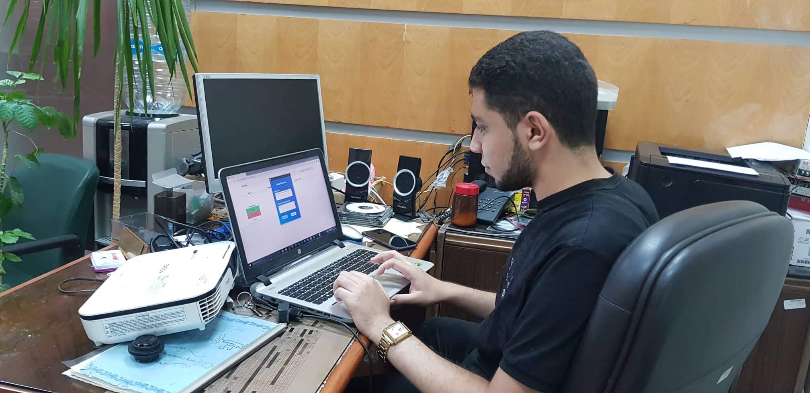
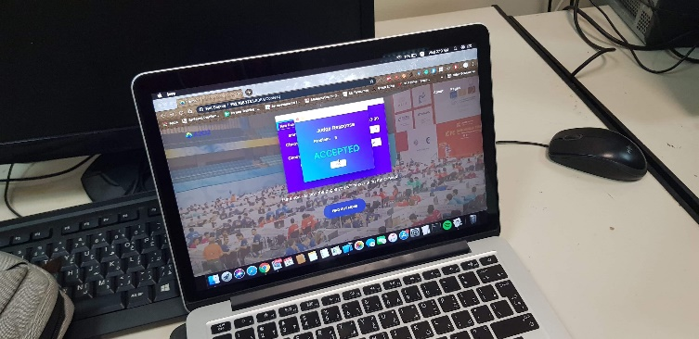
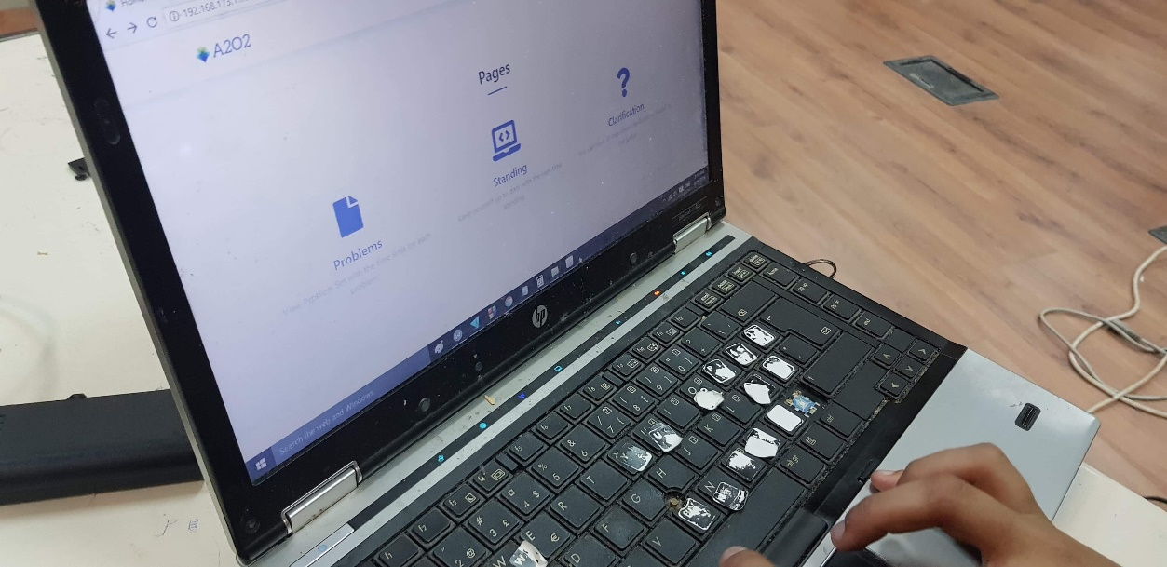
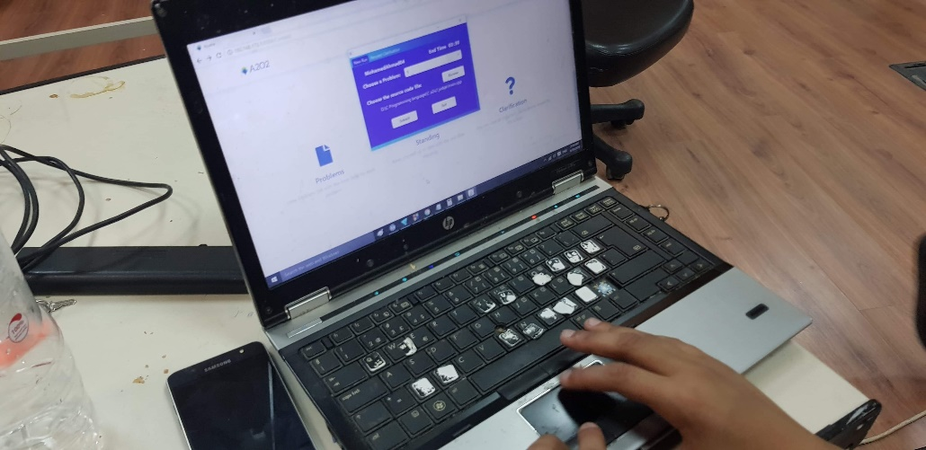
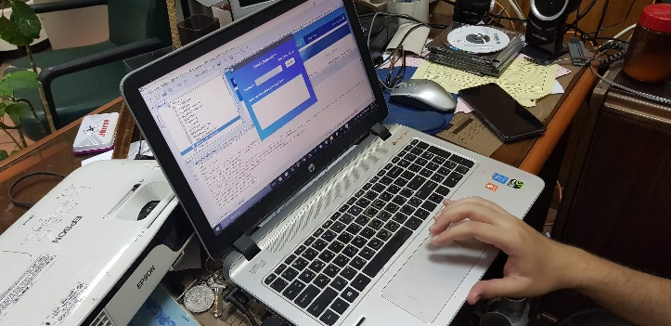
REAL CONTEST TEST

Slide 29
LIVE DEMO

Slide 30

THANK YOU
Any Questions?

